Slide 1

PENENTUAN RANKING MAHASISWA TERBAIK MENGGUNAKAN METODE SAW
Anggota Kelompok :
1.Prudenca Ahmad Daffa Kurnia (123190005)
2.Naufal Nur Fahriza (123190024)
Juli 10, 2021

Slide 2

Agenda
Studi Kasus
Metode SAW
Alasan Menggunakan Metode SAW
Langkah Langkah Analisis
Program
Output Program
Perhitungan Manual
Selesai

Slide 3

Studi Kasus
Suatu Universitas ingin menentukan mahasiswa berprestasi berdasarkan nilai tertinggi, perolehan tersebut akan digunakan sebagai ranking, dengan acuan perhitungan dari nilai UAS,UTS,Tugas,Dan Tes.

Slide 4

Metode Simple Additive Weighting (SAW)
Metode Simple Additive Weighting (SAW) dikenal dengan istilah metode penjumlahan terbobot
Konsep dasar pada metode SAW adalah mencari penjumlahan terbobot dari rating kinerja pada setiap alternatif di semua atribut.
Metode SAW membutuhkan proses normalisasi matriks keputusan (X) ke suatu skala yang dapat diperbandingkan dengan semua rating alternatif yang ada.

Slide 5
Alasan menggunakan metode SAW
Data yang dihasilkan tepat dan sesuai dengan perhitungan
Dapat digunakan dengan banyaknya atribut
Konsep logika metode SAW mudah dimengerti

Slide 6
Langkah Langkah Analisis
Penentuan Kriteria
Penentuan Rating Kepentingan dan Bobot Preferensi
Penentuan Bobot Preferensi Berdasarkan Kriteria
Penentuan Bobot Preferensi Berdasarkan Atribut

Slide 7
PEMBAHASAN PROGRAM PERENGKINGAN MAHASISWA
Program Input Data Mahasiswa
<div class="container">
<div class="card shadow my-5">
<div class="card-header text-center">
<h3>Input Data Mahasiswa </h3>
</div>
<div class="card-body">
<?php
$carikode = mysqli_query($konek_db, "select max(NIM) from tb_mahasiswa");
$datakode = mysqli_fetch_array($carikode);
if ($datakode) {
$nilaikode = substr($datakode[0], 1);
$kode = (int) $nilaikode;
$kode = $kode + 1;
$hasilkode = "S".str_pad($kode, 3, "0", STR_PAD_LEFT);
} else {
$hasilkode = "S001";
}
?>

Slide 8
Program Input Data Mahasiswa
<form name="frm" id="myForm" method="post" enctype="multipart/form-data">
<div class="form-group has-feedback">
<label for="nim">NIM :</label>
<input type="text" name="nim" class="form-control" required name="id" data-error="Isi kolom dengan benar"
value="<?php echo $hasilkode; ?>" readonly>
<span class="glyphicon form-control-feedback" aria-hidden="true"></span>
<div class="help-block with-errors" role="alert"></div>
</div>
<div class="form-group has-feedback">
<label for="nama">Nama :</label>
<input type="text" name="nama" class="form-control" required name="nama"
data-error="Isi kolom dengan benar">
<span class="glyphicon form-control-feedback" aria-hidden="true"></span>
<div class="help-block with-errors" role="alert"></div>
</div>
<div class="form-group has-feedback">
<label for="tgllahir">Tanggal Lahir :</label>
<input type="text" id="coldate1" name="tgllahir" class="form-control IP_calendar" alt="date"
title="Y/m/d"><br>
</div>
<div class="form-group has-feedback">
<label for="asalkampus">Asal Kampus :</label>
<input type="text" name="asalkampus" class="form-control" data-error="Isi kolom dengan benar">
<span class="glyphicon form-control-feedback" aria-hidden="true"></span>
<div class="help-block with-errors" role="alert"></div>
</div>

Slide 9
Program Input Data Mahasiswa
<div class="form-group has-feedback">
<label for="notelp">No Telp :</label>
<input type="text" name="notelp" class="form-control" required data-error="Isi kolom dengan benar">
<span class="glyphicon form-control-feedback" aria-hidden="true"></span>
<div class="help-block with-errors" role="alert"></div>
</div>
</div>
<div class="card-footer">
<button type="submit" name="submit" class="btn btn-primary" onclick="return checkInput()">Simpan</button>
</div>

Slide 10
Program Input Data Nilai
<div class="container">
<div class="card shadow my-5">
<div class="card-header text-center">
<h3>Input Data Nilai </h3>
</div>
<div class="card-body">
<form name="frm" id="myForm" method="post" enctype="multipart/form-data">
<form id="form1" name="form1" method="post" action="idatanilai.php">
<label class="control-label col-sm-3" for="nama">NIM :</label>
<div class="col">
<select class="form-control" name="nim" onChange='this.form.submit();'>
<option>Nomor Induk Mahasiswa</option>
<?php
$query="select * from tb_mahasiswa ORDER BY NIM ASC";
$result=mysqli_query($konek_db, $query);
if(mysqli_num_rows($result) != 0){
while($data = mysqli_fetch_assoc($result)){
echo '<option>'.$data['NIM'].'</option>';
}
} ?>
</select><br>
</div>

Slide 11
Program Input Data Nilai
<div class="form-group has-feedback">
<label class="control-label col-sm-3" for="nama">Nama :</label>
<div class="col">
<input type="text" name="nama" class="form-control" data-error="Isi kolom dengan benar">
<span class="glyphicon form-control-feedback" aria-hidden="true"></span>
<div class="help-block with-errors" role="alert"></div>
</div>
</div>
<div class="form-group has-feedback">
<label class="control-label col-sm-3" for="uas">Nilai UAS :</label>
<div class="col">
<input type="text" name="uas" class="form-control" data-error="Isi kolom dengan benar">
<span class="glyphicon form-control-feedback" aria-hidden="true"></span>
<div class="help-block with-errors" role="alert"></div>
</div>
</div>
<div class="form-group has-feedback">
<label class="control-label col-sm-3" for="uts">Nilai UTS :</label>
<div class="col">
<input type="text" name="uts" class="form-control" required data-error="Isi kolom dengan benar">
<span class="glyphicon form-control-feedback" aria-hidden="true"></span>
<div class="help-block with-errors" role="alert"></div>
</div>
</div>

Slide 12
Program Input Data Nilai
<div class="form-group has-feedback">
<label class="control-label col-sm-3" for="tugas">Nilai Tugas :</label>
<div class="col">
<input type="text" name="tugas" class="form-control" required data-error="Isi kolom dengan benar">
<span class="glyphicon form-control-feedback" aria-hidden="true"></span>
<div class="help-block with-errors" role="alert"></div>
</div>
</div>
<div class="form-group has-feedback">
<label class="control-label col-sm-3" for="tes">Nilai Tes Masuk :</label>
<div class="col">
<input type="text" name="tes" class="form-control" required data-error="Isi kolom dengan benar">
<span class="glyphicon form-control-feedback" aria-hidden="true"></span>
<div class="help-block with-errors" role="alert"></div>
</div>
</div>
</div>
<div class="card-footer">
<button type="submit" name="submit" class="btn btn-primary"
onclick="return checkInput()">Simpan</button><br><br>

Slide 13
Program Input Data Bobot
<div class="container">
<div class="card shadow m-5">
<div class="card-header text-center">
<h3>Input Data Bobot </h3>
</div>
<div class="card-body">
<form name="frm" id="myForm" method="post" enctype="multipart/form-data">
<div class="form-group has-feedback">
<label class="control-label col-sm-3" for="uas">Bobot UAS :</label>
<div class="col">
<input type="text" name="uas" class="form-control" required name="id" data-error="Isi kolom dengan benar">
<span class="glyphicon form-control-feedback" aria-hidden="true"></span>
<div class="help-block with-errors" role="alert"></div>
</div>
</div>
<div class="form-group has-feedback">
<label class="control-label col-sm-3" for="uts">Bobot UTS :</label>
<div class="col">
<input type="text" name="uts" class="form-control" required name="nama"
data-error="Isi kolom dengan benar">
<span class="glyphicon form-control-feedback" aria-hidden="true"></span>
<div class="help-block with-errors" role="alert"></div>
</div>
</div>

Slide 14
Program Input Data Bobot
<div class="form-group has-feedback">
<label class="control-label col-sm-3" for="tugas">Bobot Nilai Tugas :</label>
<div class="col">
<input type="text" name="tugas" class="form-control" data-error="Isi kolom dengan benar">
<span class="glyphicon form-control-feedback" aria-hidden="true"></span>
<div class="help-block with-errors" role="alert"></div>
</div>
</div>
<div class="form-group has-feedback">
<label class="control-label col-sm-3" for="tes">Bobot Tes Masuk :</label>
<div class="col">
<input type="text" name="tes" class="form-control" required data-error="Isi kolom dengan benar">
<span class="glyphicon form-control-feedback" aria-hidden="true"></span>
<div class="help-block with-errors" role="alert"></div>
</div>
</div>
</div>
<div class="card-footer">
<button type="submit" name="submit" class="btn btn-primary"
onclick="return checkInput()">Simpan</button><br><br>

Slide 15
Program Normalisasi
<li class="nav-item">
<a class="nav-link active" href="normalisasi.php">Normalisasi</a>
</li>
<div class="panel panel-info">
<div class="panel-body">
<h4>Matriks Keputusan</h4>
<table width="100%" class="table table-sm table-bordered table-hover" id="dataTables-example">
<thead>
<tr>
<th>NIM</th>
<th>UAS</th>
<th>UTS</th>
<th>Nilai Tugas</th>
<th>Nilai Tes Masuk</th>
</tr>
</thead>
<?php
$sql="SELECT NIM,UAS,UTS,nilaitugas,nilaitesmasuk FROM tb_nilai";
$result=mysqli_query($konek_db,$sql);
while($row=mysqli_fetch_array($result)){
$NIM = $row[0];
$UAS = $row[1];
$UTS = $row[2];
$nilaitugas = $row[3];
$nilaitesmasuk = $row[4];
echo "
<tr>

Slide 16
Program Normalisasi
<td>".$NIM."</td>
<td>".$UAS."</td>
<td>".$UTS."</td>
<td>".$nilaitugas."</td>
<td>".$nilaitesmasuk."</td>
</tr>
";
}
?>
</table>
<hr>
<h4>Nilai Max</h4>
<table width="100%" class="table table-sm table-bordered table-hover" id="dataTables-example">
<thead>
<tr>
<th>UAS</th>
<th>UTS</th>
<th>Nilai Tugas</th>
<th>Nilai Tes Masuk</th>
</tr>
</thead>
<?php

Slide 17
Program Normalisasi
$sql="SELECT MAX(UAS), MAX(UTS), MAX(nilaitugas), MAX(nilaitesmasuk)FROM tb_nilai";
$result=mysqli_query($konek_db,$sql); //row melihat dari sql
while($row=mysqli_fetch_array($result)){
$MaxUAS =$row[0];
$MaxUTS =$row[1];
$MaxNilaitugas =$row[2];
$MaxNilaitesmasuk =$row[3];
}
echo "
<tr>
<td>".$MaxUAS."</td>
<td>".$MaxUTS."</td>
<td>".$MaxNilaitugas."</td>
<td>".$MaxNilaitesmasuk."</td>
</tr>
";
?>
</table>
<hr>
<h4>Nilai Max</h4>
<table width="100%" class="table table-sm table-bordered table-hover" id="dataTables-example">
<thead>
<tr>
<th></th>
<th>UAS</th>
<th>UTS</th>
<th>Nilai Tugas</th>
<th>Nilai Tes Masuk</th>
</tr>
</thead>
<?php

Slide 18
Program Normalisasi
$sql="SELECT NIM, UAS, UTS, nilaitugas, nilaitesmasuk FROM tb_nilai";
$result=mysqli_query($konek_db,$sql) or die(mysql_error()); //row melihat dari sql
while($row = mysqli_fetch_array($result)){
$NIM =$row[0];
$bUAS =$row[1]/$MaxUAS;
$bUTS =$row[2]/$MaxUTS;
$bTugas =$row[3]/$MaxNilaitugas;
$bTes =$row[4]/$MaxNilaitesmasuk;
echo "
<tr>
<td>".$NIM."</td>
<td>".$bUAS."</td>
<td>".$bUTS."</td>
<td>".$bTugas."</td>
<td>".$bTes."</td>
</tr>
";
}
?>
</table>
</div>
</div>
</div>

Slide 19
Program Perangkingan
<li class="nav-item">
<a class="nav-link active" href="perangkingan.php">Perangkingan</a>
</li>
</ul>
<?php
$sql="SELECT MAX(UAS), MAX(UTS), MAX(nilaitugas), MAX(nilaitesmasuk)FROM tb_nilai";
$result=mysqli_query($konek_db,$sql); //row melihat dari sql
while($row=mysqli_fetch_array($result)){
$MaxUAS =$row[0];
$MaxUTS =$row[1];
$MaxNilaitugas =$row[2];
$MaxNilaitesmasuk =$row[3];
}
?>
<br>
<div class="panel panel-info">
<div class="panel-body">
<table width="100%" class="table table-sm table-bordered table-hover" id="dataTables-example">
<thead>
<tr>
<th>NIM</th>
<th>UAS</th>
<th>UTS</th>
<th>Nilai Tugas</th>
<th>Nilai Tes Masuk</th>
<th>Total Nilai</th>
<th>Rangking</th>
</tr>
</thead>
<?php

Slide 20
Program Perangkingan
$sql="SELECT NIM, UAS, UTS, nilaitugas, nilaitesmasuk,
B_UAS, B_UTS, B_nilaitugas, B_tesmasuk
FROM tb_nilai, tb_bobot ORDER BY UAS DESC, UTS DESC, nilaitugas DESC, nilaitesmasuk DESC";
$result=mysqli_query($konek_db,$sql) or die(mysql_error()); //row melihat dari sql
$rangking =0;
while($row = mysqli_fetch_array($result)){
$rangking++;
$NIM =$row[0];
$cUAS =$row[5]*($row[1]/$MaxUAS);
$cUTS =$row[6]*($row[2]/$MaxUTS);
$cTugas =$row[7]*($row[3]/$MaxNilaitugas);
$cTes =$row[8]*($row[4]/$MaxNilaitesmasuk);
$total =$cUAS + $cUTS + $cTugas + $cTes;
echo "
<tr>
<td>".$NIM."</td>
<td>".$cUAS."</td>
<td>".$cUTS."</td>
<td>".$cTugas."</td>
<td>".$cTes."</td>
<td>".$total."</td>
<td>".$rangking."</td>
</tr>
";
}
?>
</table>
</div>
</div>

Slide 21
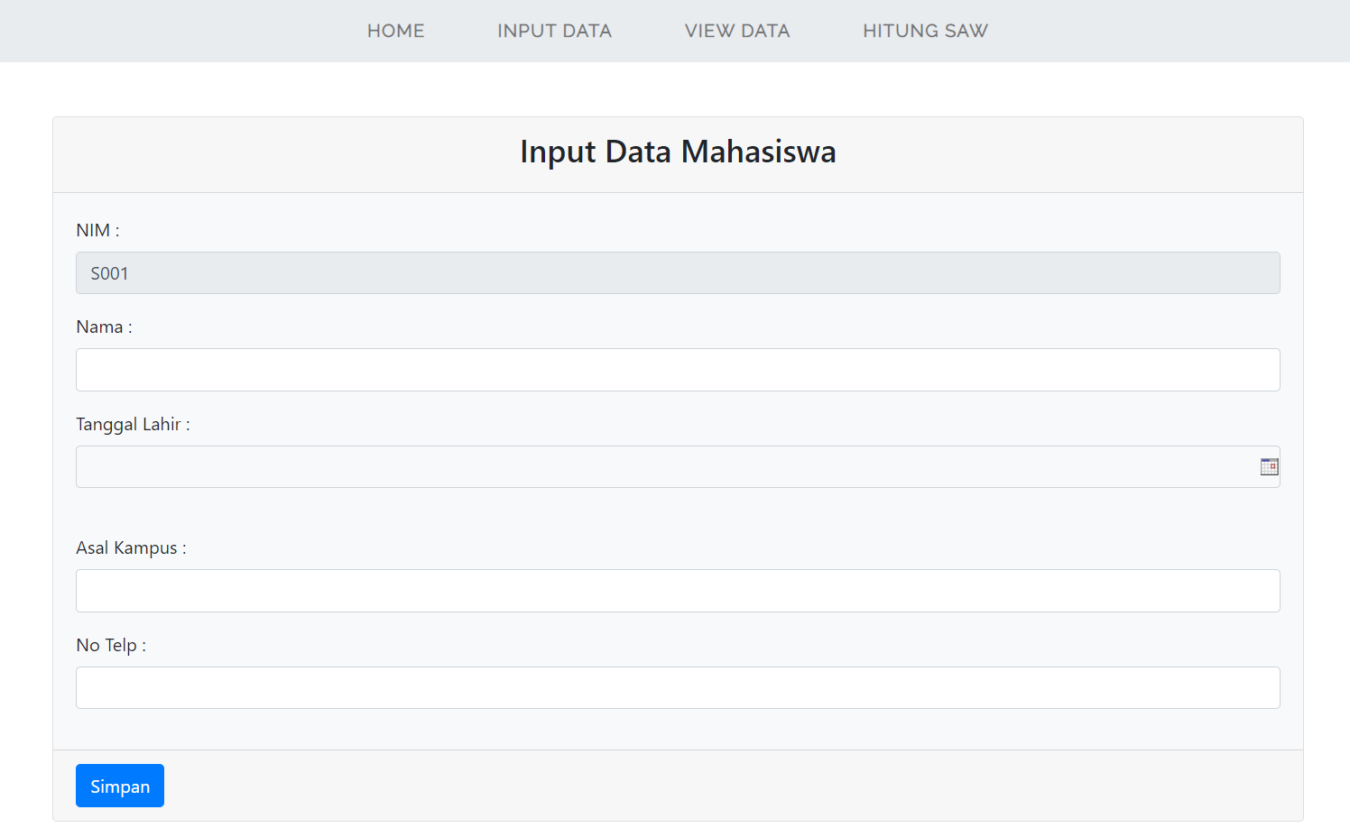
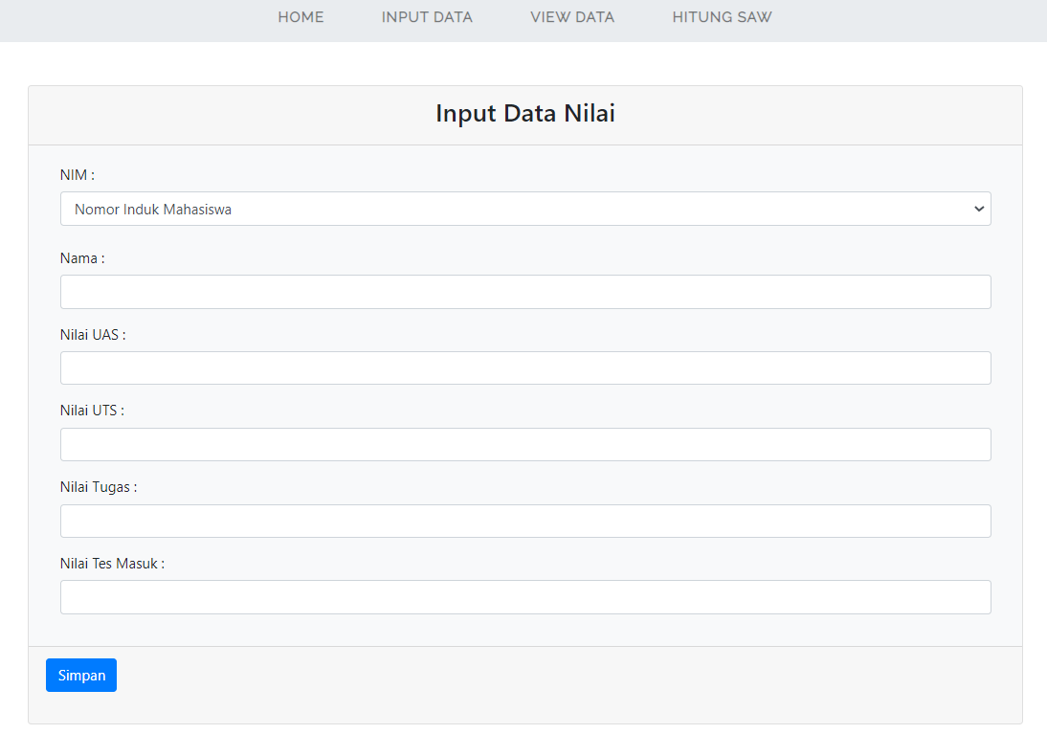
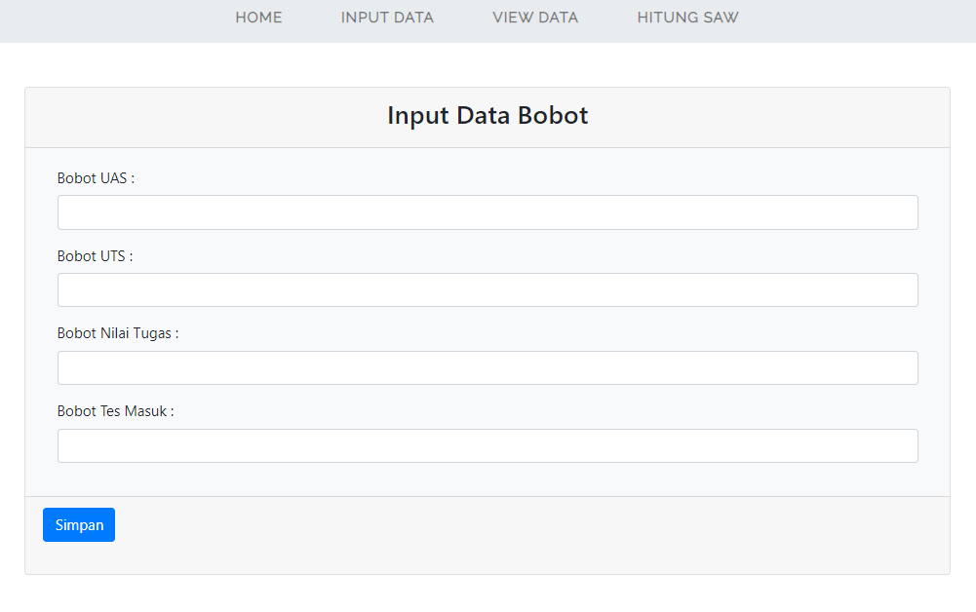
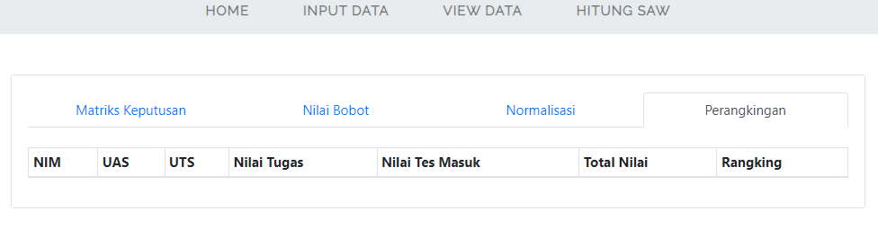
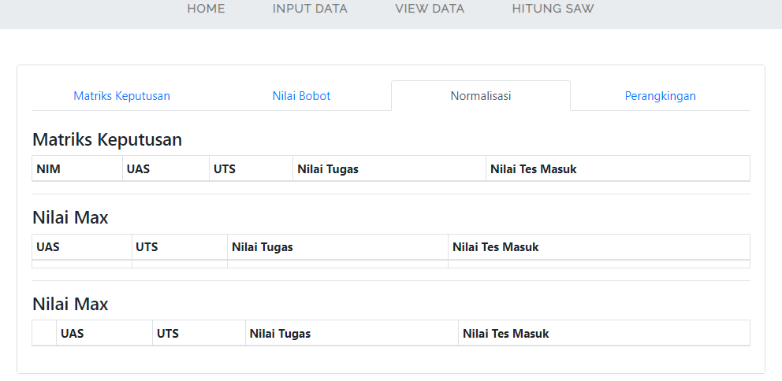
OUTPUT PROGRAM PERANKINGAN MAHASISWA

Slide 22

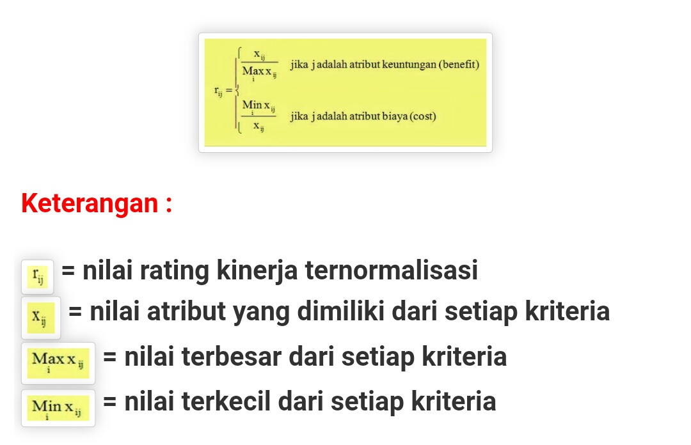
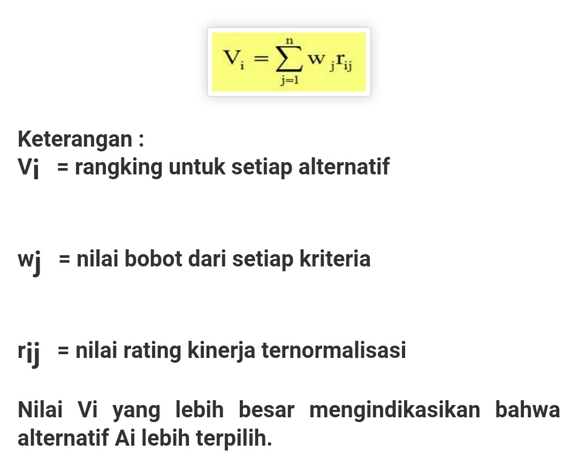
PERHITUNGAN MANUAL PERANKINGAN MAHASISWA
Rumus :
Contoh kasus :
Terdapat unversitas yang ingin melakukan perankingan terhadap mahasiswanya.
Terdapat 3 mahasiswa dengan nama dan nim: Daffa (S001), Fahri (S002), Ator(S003).
Sebagai acuan penilaian yang diambil adalah nilai UAS, UTS, Tugas, dan Tes.
Dengan bobot penilain UAS berbobot (0,4) , UTS berbobot (0,3) , Tugas bebobot (0,2) ,
dan Tes berbobot (0,1)

Slide 23
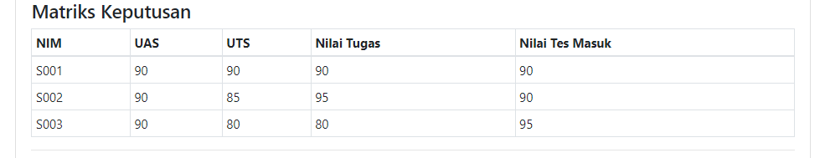
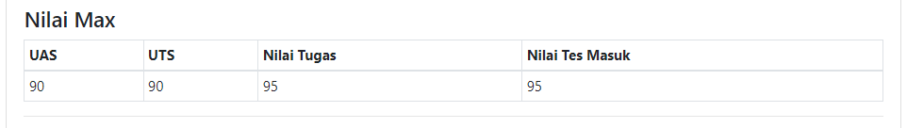
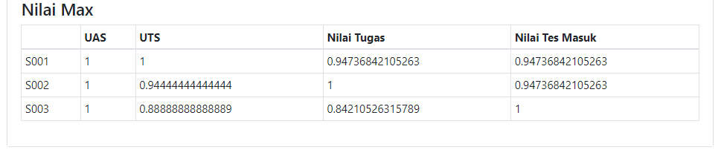
PERHITUNGAN MANUAL PERANKINGAN MAHASISWA
Langkah perhitungan :
1. Menentukan matriks keputusan :
2. Menentukan nilai max :
3. Menentukan nilai max masing masing atribut :

Slide 24
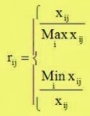
PERHITUNGAN MANUAL PERANKINGAN MAHASISWA
3. Menentukan nilai max masing masing atribut :
Normalisasi nilai Uas :
S001 : 90/max {90;90;90} = 90/90 =1
S002 : 90/max {90;90;90} = 90/90 =1
S003 : 90/max {90;90;90} = 90/90 =1
Normalisasi nilai Uts :
S001 : 90/max {90;85;80} = 90/90=1
S002 : 85/max {90;85;80} = 85/90=0,9444
S003 : 80/max {90;85;80} = 80/90=0,8889
Normalisasi nilai Tugas :
S001 : 90/max {90;95;80} = 90/95=0,9473
S002 : 95/max {90;95;80} = 95/95=1
S003 : 80/max {90;95;80} = 80/95=0,8421
Normalisasi nilai Tes :
S001 : 90/max {90;90;95} = 90/95=0,9473
S002 : 90/max {90;90;95} = 90/95=0,9473
S003 : 95/max {90;90;90} = 95/95=1

Slide 25
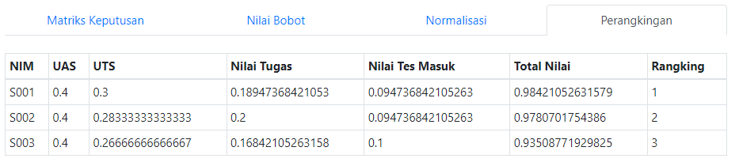
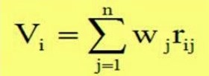
PERHITUNGAN MANUAL PERANKINGAN MAHASISWA
4. Menentukan nilai ranking masing masing atribut :
4. Menentukan nilai ranking masing masing atribut :
Bobot :
WS001= 0,4 x 1 = 0,4
WS001 = 0,3 x 1 = 0,3
WS001 = 0,2 x 0,947 = 0,1894
WS001 = 0,1 x 0,947 = 0,0947
WS002 = 0,4 x 1 = 0,4
WS002 = 0,3 x 0,944 = 0,2833
WS002 = 0,2 x 1 = 0,2
WS002 = 0,1 x 0,947 = 0,0947
WS003 = 0,4 x 1 = 0,4
WS003 = 0,3 x 0,889 = 0,2667
WS003 = 0,2 x 0,8421 = 0,16842
WS003 = 0,1 x 1 = 0,1
Wj/bobot = UAS{0,4},UTS{0,3},Tugas{0,2},Tes{0,1}
Vi = Ranking
V1 = (0,4+0,3+1,894+0,0947) = 0,98421
V2 = (0,4+0,2833+0,2+0,0947)=0,9780
V3 = (0,4+0,2667+0,16842+0,1)=0.93508

Slide 26
TERIMAKASIH

